Slide 1

WM’s Response to Support Washoe County
APRIL 2020
Notes:
I

Slide 2

Serving & Protecting Our Employees
Frontline Employees – Servicing our Communities Every Day!
Protecting our frontline employees while they are providing essential services:
Putting our People First commitment into practice
  Adhering to the latest information from the Centers for Disease Control and Prevention (CDC), Occupational Safety & Health Administration (OSHA) and other agencies
  Wage and benefit guarantees
  No layoffs. Guarantee of 40 hours per week.
  Access to and assistance with childcare and eldercare
  Enhancement of medical benefits to cover all cost related to COVID-19
Prioritizing social distancing
  New practices for our drivers and MRF workers to allow for distancing
  Enhanced PPE procedures drivers, MRF and transfer station workers include hand sanitizer and masks
  Provided remote work options for office and customer service staff

Slide 3



Solutions Focused on Service
We are delivering service and support – today and always.
Excess Waste and Bulk collection delayed in some areas to maximize use of collection arm and reduce driver contact with waste. Focus placed on driver safety and maintaining the essential service of curbside collection of household waste Social Distancing and PPE protocols implemented at transfer stations, Lockwood Landfill and Ecocenter Employee attendance has continued to be exceptional |  | Suspend late fees, finance charges, collection activities and service suspensions Temporarily suspended bill collection calls and service cut-offs Proactively reaching out to customers to reduce or increase service in impacted industries Commercial services were reduced or suspended to deal with individual customer needs or Health Department regulation |  | Call Centers fully operational with a work-from-home option Established platform technology and network capabilities, including chat, chatbot, and email Developed remote work guidelines and training Additional self-service investments accelerated for customer ease including the newly updated MyWM cell phone app
Delivering Essential Services
Agile & Customer Focused
Adapting to a Changing World

Slide 4
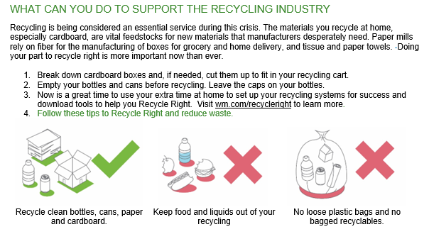


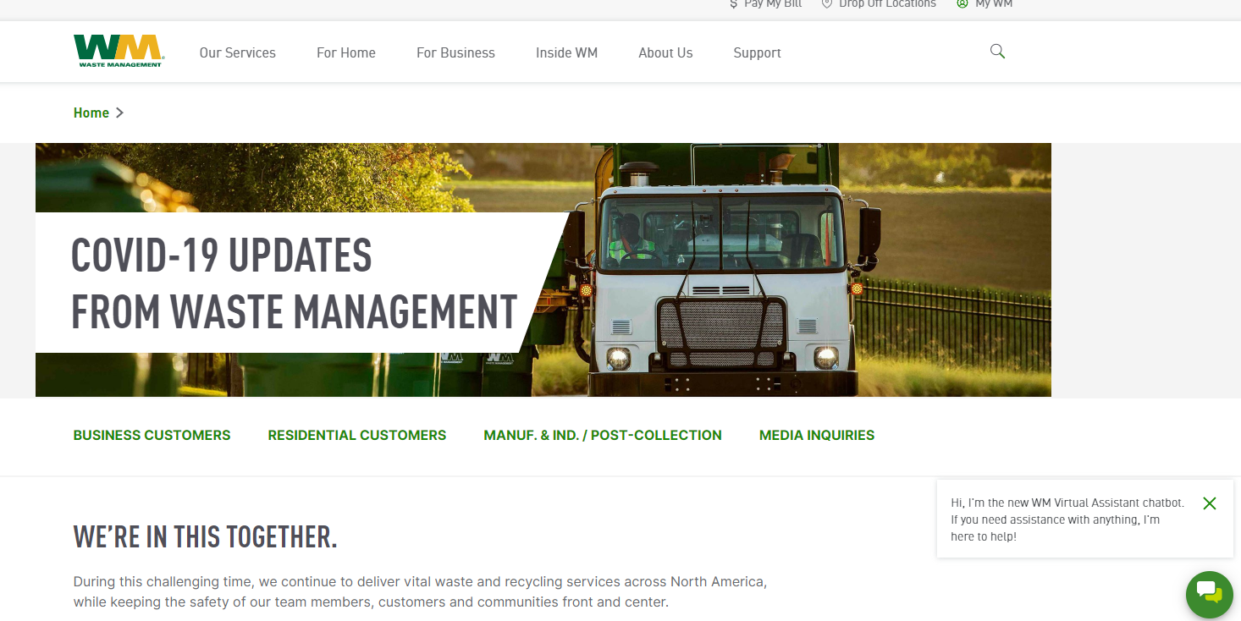
Solutions Focused on Communications
Developing Real-time Communication in Times of Need
COVID-19 landing page on wm.com (wm.com/covid19)
Area Service Alerts – providing routine service updates – suspensions, reinstatement of services, etc. (wm.com/alerts)
COVID-19 FAQs and automated “chatbot” on wm.com 24/7
Proactive customer emails and outbound calls where customers have opted in
Partnership and support for local communications teams such as the Washoe County JIC
What We’re Hearing From Our Customers
Customer feedback has been overwhelmingly positive. Customers are grateful that drivers are reliable and responsive. Most residents are thankful that these employees risk the safety of themselves and their families every day to provide this essential service

Slide 5

Next Steps – Working Together
Return to Normalcy
Our commitment to each other
Stay engaged and meet regularly in a preferred virtual environment and to provide COVID-19 updates
Remain agile to continue to serve the needs of the community
Improving self-service options to reduce customer wait times and keep the most current information available on demand.
Return commercial customers to normal schedules as businesses continue to open
Washoe County extra bag program usually scheduled for May will occur for a full 4 week period once normal operations resume

Slide 6
THANK YOU & STAY SAFE!

