Slide 1
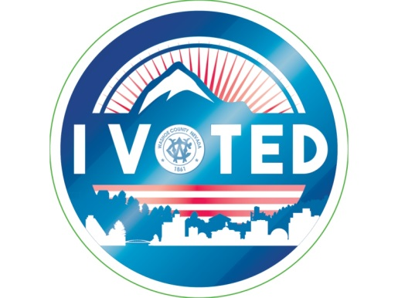
Registrar of Voters
2020 GENERAL ELECTION
November 3, 2020

Slide 2
Registrar of Voters
Going into the 2020 Elections – The Year of Change:
Internal Department Goals
Interactive Sample Ballot
Adopt a Polling Place Program (AAPP)
Wait times App
Results Reporting Dashboard
Ballottrax
COVID-19
All mail-in and in-person voting for General Election per AB 4
Secretary of State’s Office procurement of envelope sorter

Slide 3
Registrar of Voters
ELECTION STATISTICS
REGISTERED VOTERS IS WASHOE COUNTY – 304,224
Democratic – 107,807
Republican – 108,586
Minor Party/Nonpartisans – 87,831

Slide 4
Registrar of Voters
ELECTION STATISTICS
2020 General Turnout by Tally Type
Mail-In 132,241
Early Voting 95,595
Election Day 24,727
Total 252,563
A WASHOE COUNTY HISTORIC TURNOUT
83.02%

Slide 5
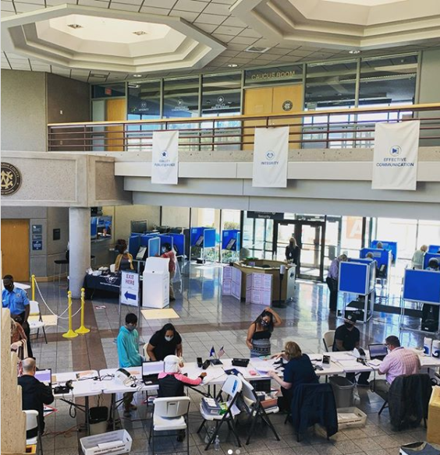
Registrar of Voters
Early Voting
15 In-Person Polling Locations
15 Ballot Drop Off Locations
328 Early Voting Election Workers

Slide 6
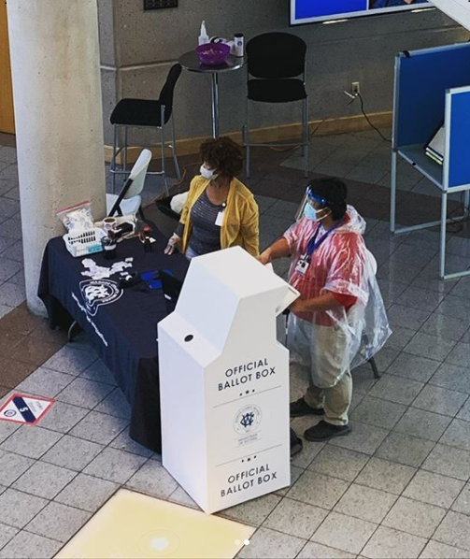
Registrar of Voters
Election Day
29 In-Person Polling Locations
16 Ballot Drop Off Locations

Slide 7
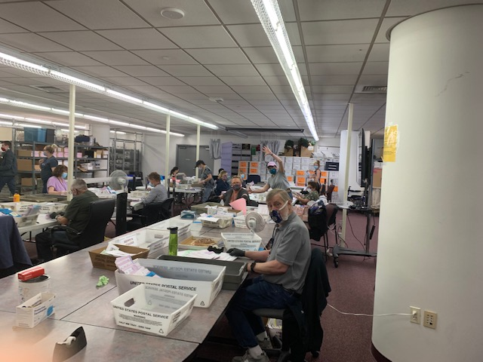
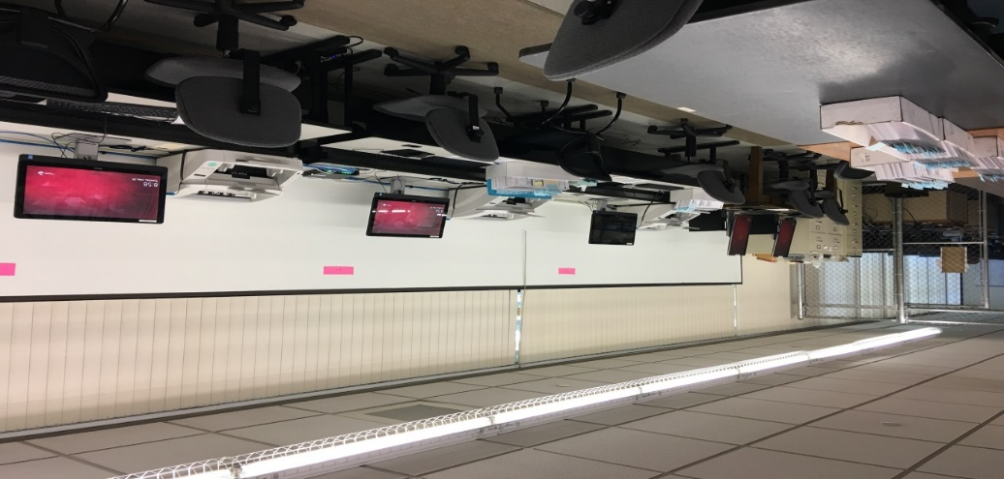
Registrar of Voters
Mail In Ballot Processing
Number of Ballots Issued = 303,239
Number of Ballots Returned = 132,241

Slide 8
Registrar of Voters
County Departments
Alternative Public Defenders
Alternative Sentencing
Children's Services
Community Services
Comptroller
Health Services
Juvenile Services
Library
Public Defenders
Recorders
Reno Justice
Sheriffs
Technology Services
Treasurer
THANK YOU FOR VOLUNTEERING!

Slide 9
Registrar of Voters
Special Thanks to Our Adopt a Polling Place Partners
Alternative Public Defenders Office Damonte Ranch High School
Students of Galena High School
Galena High School
Resolute Capital Partners
Reno High School
Lord of Mercy Lutheran Church
Sky Ranch Middle School
The Holland Project
Wooster High School
Girl Scouts of Spanish Springs
Spanish Springs High School
Nevada Circle K International
Wilbur D. May Museum
Norther Nevada International Center
Registrar of Voters
Total fundraising earnings for each group was between $4,840 - $5,940

Slide 10
Registrar of Voters
POST-ELECTION ACTIVITY
Per NRS 293B.155 as required by NRS 293B.165, Post-LAT completed on November 12 , 2020 and was completed with no errors.
Provisional Ballots have been processed and are included in the final results.
Reconciliation completed with no unexplained errors.
Final abstract has been printed and vote history posted.
Post election audit completed , November 12, by the Accuracy Certification Board (ACB)
Current Certification Board Members are: Steve Davidek, Jean Stoess, Norm Schiff, and Dave Harbeck

Slide 11
Registrar of Voters
VVPAT AUDIT
ICX Prime Voting Tablets were audited by the Accuracy Certification Board (ACB) on Thursday November 12, 2020. The VVPAT Audit (NAC 293.255) requires that at least 2% or 20 voting machine’s paper audit trails be reviewed for accuracy (whichever is greater). Our ACB chose to audit 22 machines to review.
This is done by scanning the QR codes for each copy of the ballot cast. Those are totaled and compared to the print-out from the results flash drive. The ACB also reviews at least two sets of individual votes cast visually and compares that to the VVPAT to make certain the QR code for each ballot choices are being accurately reflected.
No errors were found.

Slide 12
Registrar of Voters
STAFF INTRODUCTIONS – Team ROV
Heather Carmen – Assistant Registrar of Voters
Cate Salim – Equipment Supply Manager/Polling Place Coordinator AND Absent Ballot Coordinator
Jon Brown – Poll Worker Recruiter and Trainer
Michael Chavez – Front Office and Correspondence Manager
Mike Mulreany – Department Systems Specialist
Brian Takemoto – Technology Services (Responsible for everything)
Dan Simpson – Technology Services

Slide 13
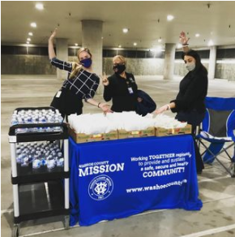
Registrar of Voters
FINAL THANK YOU TO:
County Manager’s Office for their continued support
Communications Team
Technology Services
Our Voters

Slide 14
Registrar of Voters
Voter Registration and Elections Administration
Thank You

